Slide 1

W2M THAILAND
2027 PRODUCT &
CONTRACT PORTFOLIO

Slide 2


This updated presentation is based on the current 2027 working files, including rate books, itineraries, website upload assets, and product code alignment documents.

Slide 3
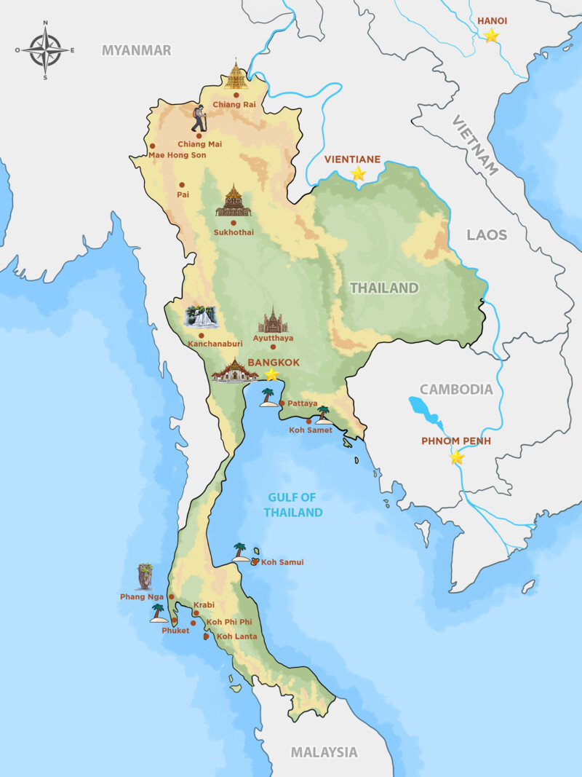
2027 FOOTPRINT
The current 2027 portfolio combines city, cultural, overland, and beach programs across Thailand.
Bangkok and Central Thailand cover temples, markets, UNESCO sites, river journeys, and classic overland links.
Northern Thailand centers on Chiang Mai and Chiang Rai with temple, elephant, hill-tribe, and mountain experiences.
Phuket and Krabi extend the portfolio with island, resort, and Andaman transfer coverage.
The active working set includes 24 excursions, 10 package tours, and 50 transfer routes prepared for contracting.
This creates a practical product base for FIT, private touring, and pre-designed multi-day journeys.

Slide 4
INDEX
1. 2027 contract scope
1.1 Portfolio footprint
1.2 Current commercial file set
2. Ground services
2.1 Incoming services summary
2.2 Transfer standards and conditions
3. Product portfolio
3.1 Excursions and private touring
3.2 Package tours and overlands
4. Delivery status
4.1 Current files aligned for 2027 launch

Slide 5

W2M THAILAND
2027 INCOMING SERVICES

Slide 6

W2M THAILAND 2027 PORTFOLIO
The current file set shows a partner-ready Thailand portfolio built around active contracting material.
Our 2027 scope includes:
• 24 excursions and private touring products
• 10 package tours and overland programs
• 50 transfer routes across 5 operating areas
• Contract validity from 01-July-2026 to 30-April-2027
• Web-ready download assets for rates and program files
WHY THIS UPDATE
Current rates, itineraries, and upload files are now aligned for a cleaner 2027 commercial presentation.
Source basis: current rate-data.js, itinerary library, and upload pack

Slide 7

2027 COMMERCIAL FILE SET
The deck now reflects the files currently prepared for contracting, quotation, and upload.
• Contract rate books
Excursion & Package workbook and Transfer Service workbook are already prepared in the latest 2027 set.
• Itinerary library
34 DOCX itineraries and 34 quotation-source spreadsheets support the live product list.
• Website upload pack
HTML pages, CSS, rate-data.js, PDFs, and a zipped tour-program package are ready for digital handoff.
• Code alignment
An 89-row rename map and product-code memo separate internal legacy names from W2M commercial codes.
• Reference governance
Transfer notes, terms, and comparison analysis support cleaner commercial positioning.
Updated from the current working file set

Slide 8

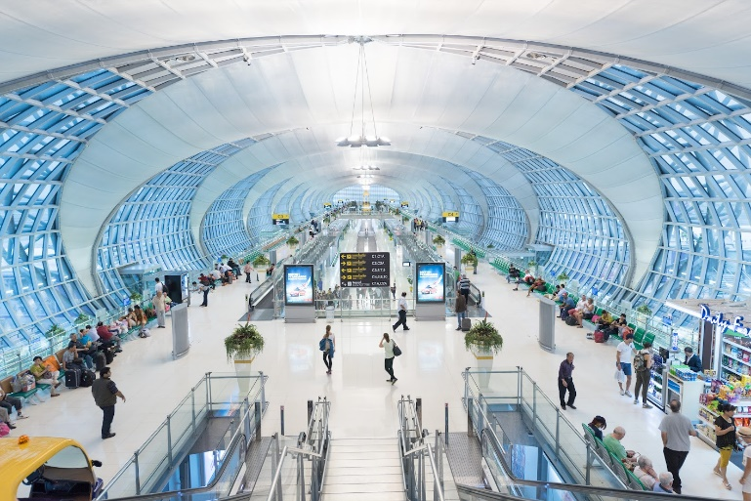
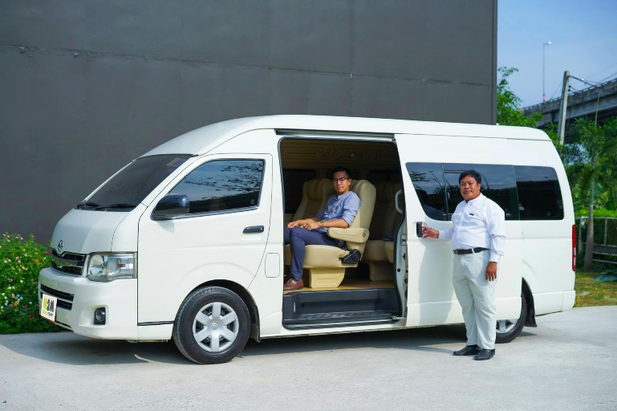
TRANSFER STANDARDS
The current 2027 transfer files position services as net per vehicle, per way, with operational notes already defined.
• Coverage footprint: 50 routes across Chiang Mai, Chiang Rai, Bangkok / Central, Phuket / Andaman, and Krabi / Andaman.
• Airport handling: flight delays are monitored and airport pick-up waiting time is included according to the current terms.
• Service inclusions: driver, private air-conditioned vehicle, tolls, bottled water, and one baby seat on request.
• Booking control: services remain subject to prior confirmation, vehicle availability, and written amendments.
• Operating standard: licensed professional drivers and well-maintained vehicles remain the stated service baseline.
Current terms updated in the 2027 transfer file set

Slide 9
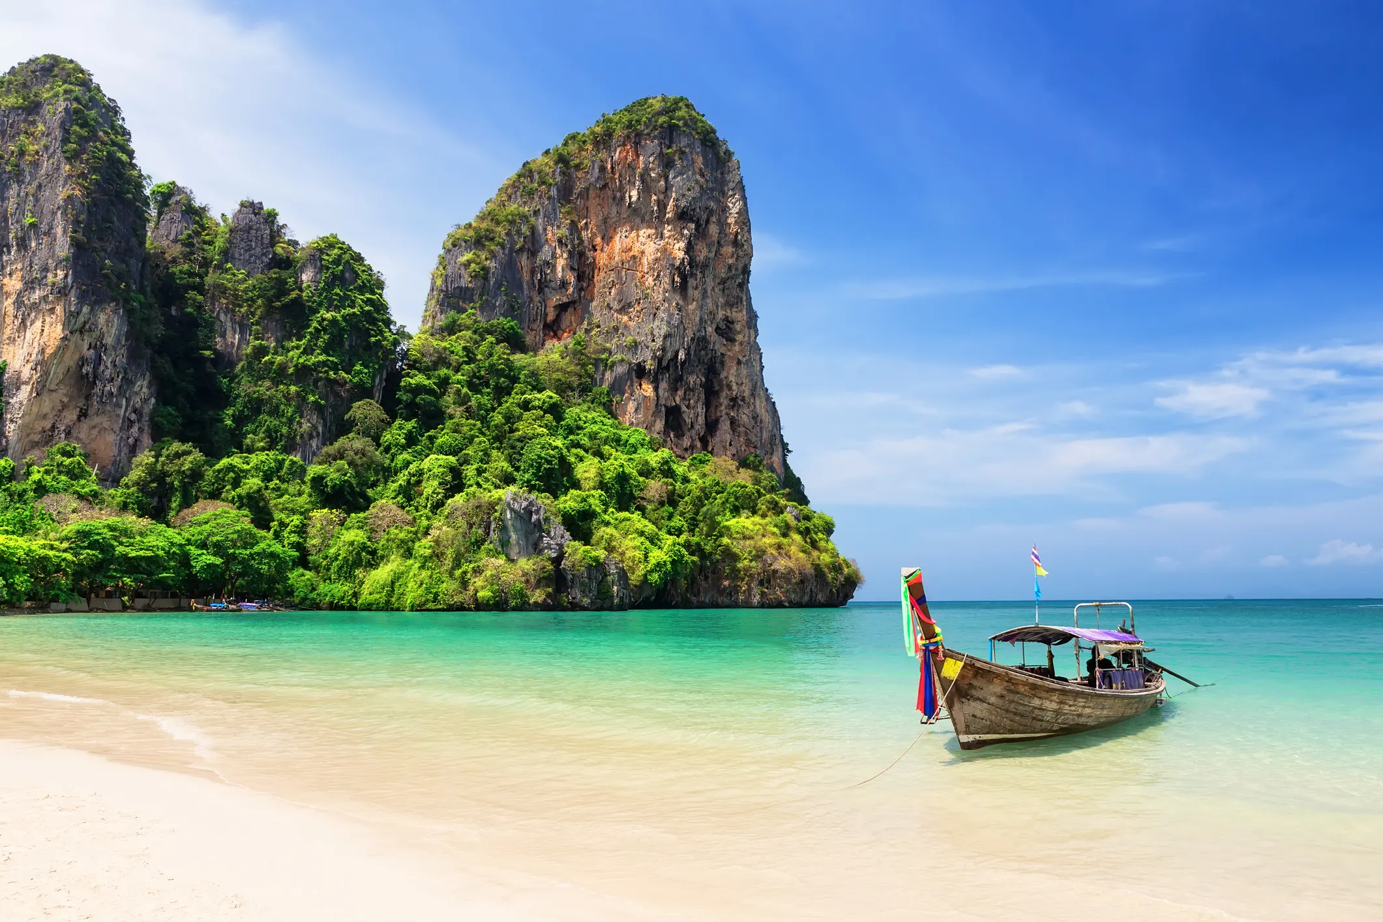

EXCURSIONS
& PRIVATE TOURING

Slide 10
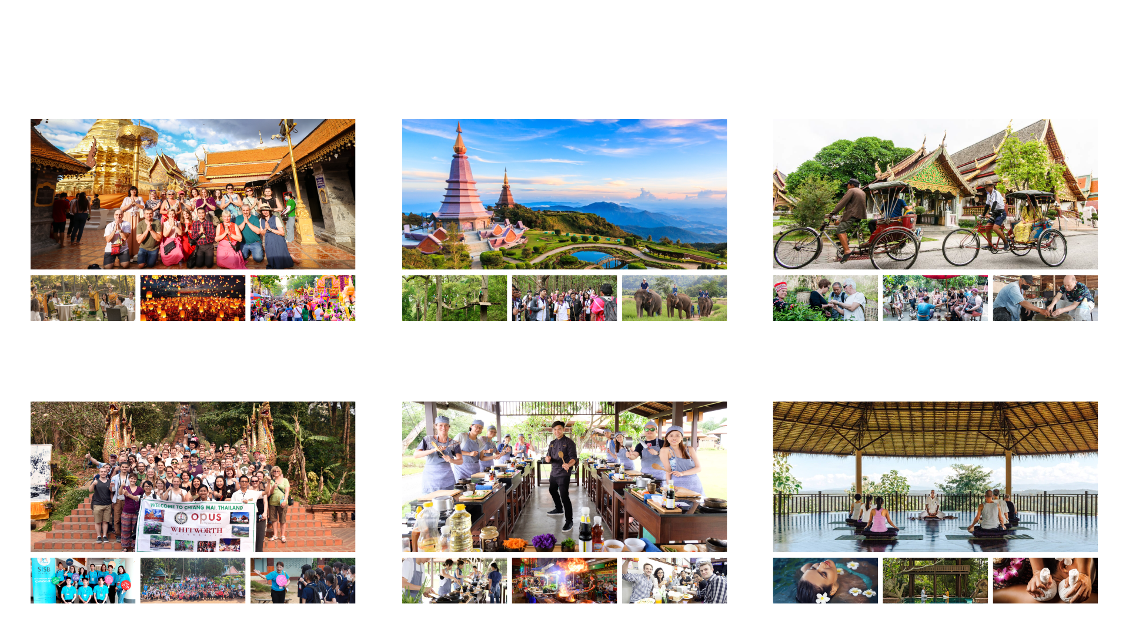
PROGRAM STYLES
The 2027 excursion list is concentrated on sellable, destination-led experiences rather than generic sightseeing categories.
Cultural Icons
Nature & Soft Adventure
Community & Local Life
24 active excursions in the current rate set
Evening & Lifestyle
Food & Market Journeys
Leisure & Wellness
Curated 2027 experiences across Thailand

Slide 11



DAY TOUR HIGHLIGHTS
The current day-tour mix is strongest in three destination clusters.
• Bangkok / Central: 10 products spanning Grand Palace, canal touring, floating market, Ayutthaya, and Kanchanaburi.
• Chiang Mai: 10 products from temple classics and ethical elephant programs to trekking and night-market experiences.
• Chiang Rai: 4 products focused on White Temple, Golden Triangle, Doi Tung, and Doi Mae Salong.
All are already tied to W2M product codes and quotation files.
Current 2027 day-tour spread

Slide 12
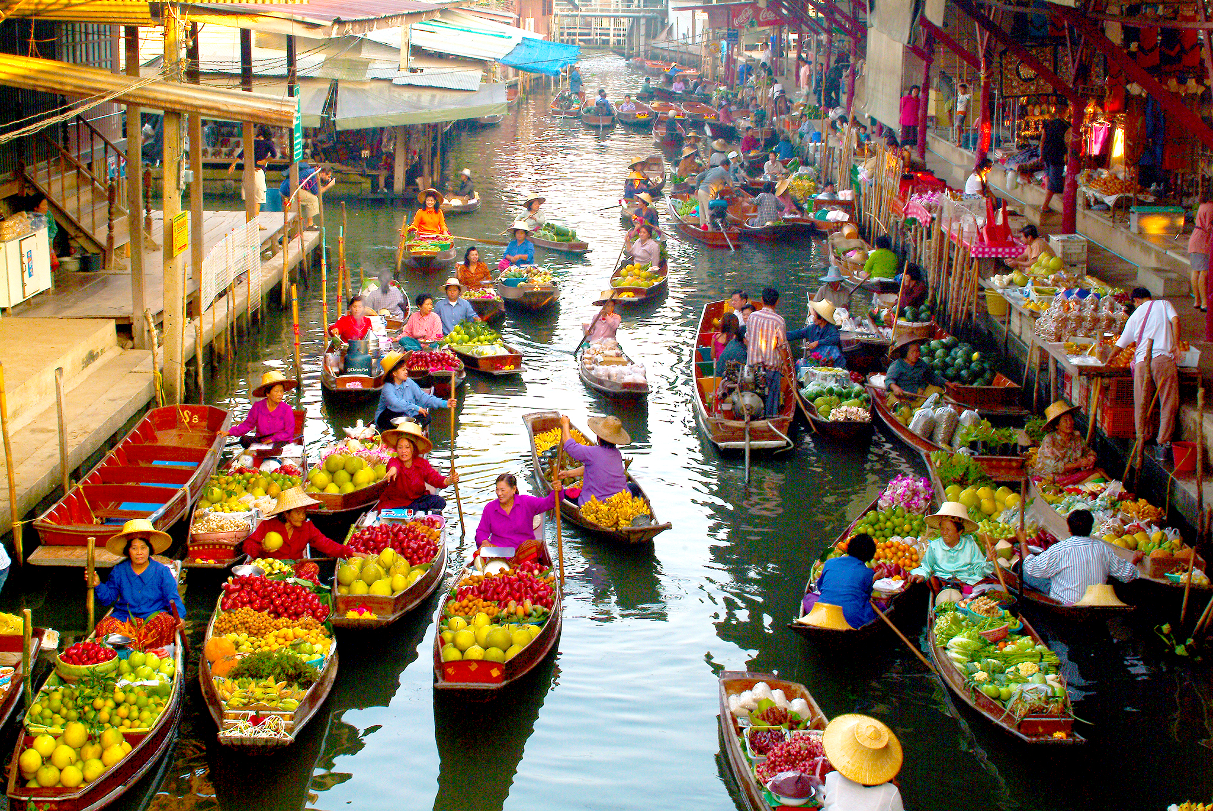
PACKAGE TOURS
& OVERLANDS

Slide 13
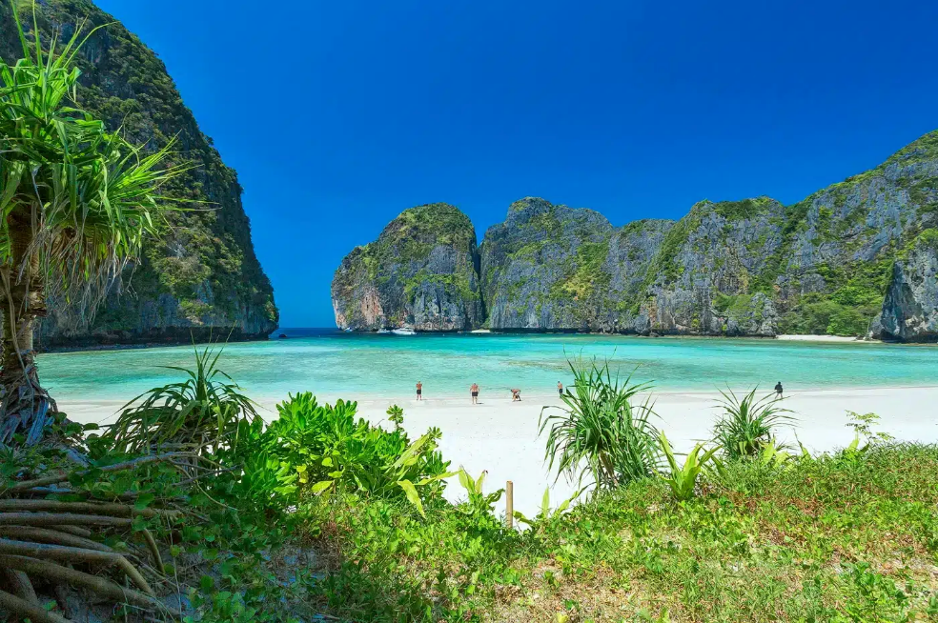
PACKAGE TOUR OVERVIEW
The current package-tour file set covers short stays, classic combinations, and longer overland routes built from the same 2027 contracting base.
• 10 active package tours
Mix of 3D2N to 8D7N programs already priced in the current rate set.
• Central and heritage routes
Bangkok, Ayutthaya, River Kwai, and Sukhothai remain key anchors for culture-led itineraries.
• Northern combinations
Chiang Mai and Chiang Rai packages combine temples, elephants, Golden Triangle, and mountain scenery.
• Southern extension
Phuket and Phi Phi add a beach-oriented option for resort and island demand.
• Commercial consistency
Package itineraries, quotation sources, and renamed product codes now point to the same 2027 structure.
10 package tours in the active 2027 set

Slide 14


READY
FOR 2027
GO-LIVE

